Slide 1


Slide 2
培训课堂注意事项
请自觉遵守培训纪律，培训期间不得旷课，没有特殊事项，不得请假。
上课期间，请将手机调至静音状态，认真听讲，如有特殊原因需接听电话，在征得讲师同意后到教室外接听。
培训期间请提前5分钟到达教室，并及时签到，每人每节课前签到一次，不得多签或代签。

Slide 3
SQL Server Optimizing Basics

Slide 4
SQL Server Optimizing Basics
Slow Queries
Execution Plan Explained
Index Basics
Identify Problematic Code

Slide 5
Slow Queries
Lack of Indexes
  select *
  from [Sales].[SalesOrderDetail]
  where CarrierTrackingNumber like '365D%'
Indexes are not used
    select *
    from [Sales].[SalesOrderDetail]
    where CarrierTrackingNumber like ‘%365D‘
    select *
    from [Sales].[SalesOrderDetail]
    where left(CarrierTrackingNumber, 4) = ‘365D'
Query is complex
  Demo
Parameter Sniffing
Hint – Collect execution cost:
set statistics time on
set statistics io on
Notes:
Why Is This Query Sometimes Fast and Sometimes Slow?
https://www.brentozar.com/archive/2016/11/query-sometimes-fast-sometimes-slow/?utm_source=Brent+Ozar+Unlimited%C2%AE+List&utm_campaign=4f08c8d8d9-RSS_EMAIL_CAMPAIGN&utm_medium=email&utm_term=0_8e3e861dd9-4f08c8d8d9-296491261
The Elephant and the Mouse, or, Parameter Sniffing in SQL Server
https://www.brentozar.com/archive/2013/06/the-elephant-and-the-mouse-or-parameter-sniffing-in-sql-server/
Parameter Sniffing Problem and Possible Workarounds
https://blogs.msdn.microsoft.com/turgays/2013/09/10/parameter-sniffing-problem-and-possible-workarounds/

Slide 6
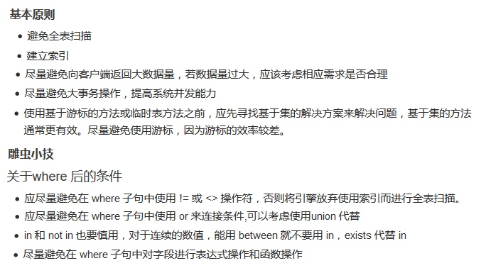
Slow Queries - Resolve

Slide 7
Execution Plan Explained
What is Execution Plan
Read Execution Plan
How the optimizer generates plans
Tools to get plans (SSMS, Profiler, DMVs)

Slide 8
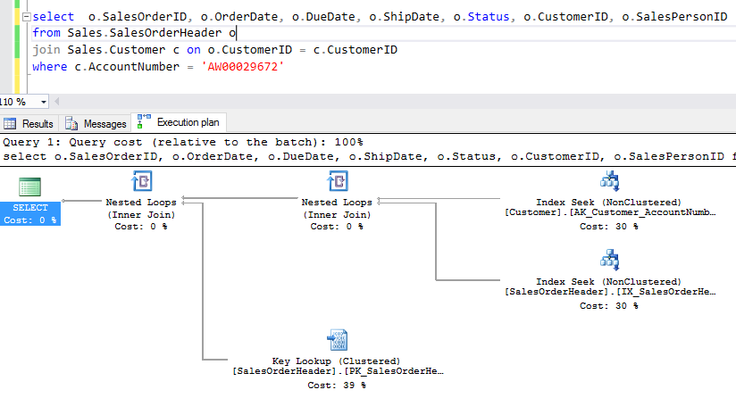
What is Execution Plan
Notes:
Algebrizer is responsible for objects and columns names (which you have provided in query or which are being referenced by your query) verification. For example if wrong name for a table is typed in a query, then its algebrizer’s duty to verify and generate an error.
· Algebrizer also identifies all data types which are being processed for a given query.
· Algebrizer verify that GROUP BY and aggregate columns are placed in right place or not. For example if you write following query and just Ctrl+F5 (just to parse). No error will be generated. But when you will press F5 (execute it). After Parsing, algebrizer will work and return an error.

Slide 9
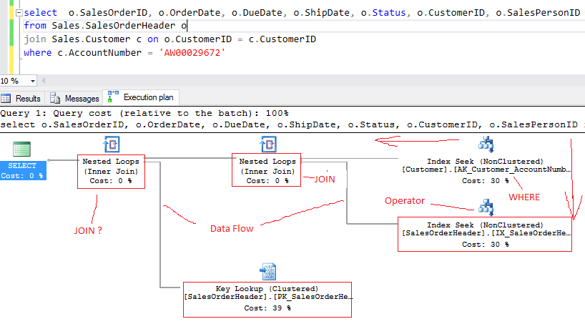
Read Plan
Notes:
Algebrizer is responsible for objects and columns names (which you have provided in query or which are being referenced by your query) verification. For example if wrong name for a table is typed in a query, then its algebrizer’s duty to verify and generate an error.
· Algebrizer also identifies all data types which are being processed for a given query.
· Algebrizer verify that GROUP BY and aggregate columns are placed in right place or not. For example if you write following query and just Ctrl+F5 (just to parse). No error will be generated. But when you will press F5 (execute it). After Parsing, algebrizer will work and return an error.

Slide 10
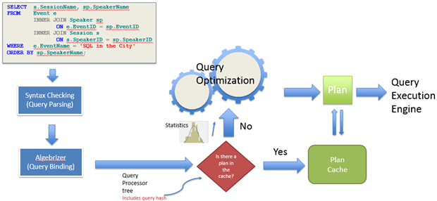
How the optimizer generates plans
Notes:
Algebrizer is responsible for objects and columns names (which you have provided in query or which are being referenced by your query) verification. For example if wrong name for a table is typed in a query, then its algebrizer’s duty to verify and generate an error.
· Algebrizer also identifies all data types which are being processed for a given query.
· Algebrizer verify that GROUP BY and aggregate columns are placed in right place or not. For example if you write following query and just Ctrl+F5 (just to parse). No error will be generated. But when you will press F5 (execute it). After Parsing, algebrizer will work and return an error.

Slide 11
How to get plans
SQL Server Management Studio
  Estimated Plan
  Actual Plan
SQL Server Profiler
DMVs
  sys.dm_exec_query_stats
  sys.dm_exec_procedure_stats

Slide 12
Index Basics
Clustered and non-clustered index
Index Types
Index Operations (Scan, Seek and Lookup)
DMVs to check uses of indexes

Slide 13
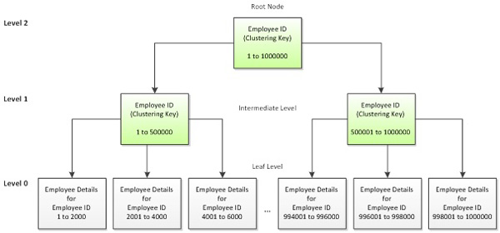
Clustered Index
Notes:
Algebrizer is responsible for objects and columns names (which you have provided in query or which are being referenced by your query) verification. For example if wrong name for a table is typed in a query, then its algebrizer’s duty to verify and generate an error.
· Algebrizer also identifies all data types which are being processed for a given query.
· Algebrizer verify that GROUP BY and aggregate columns are placed in right place or not. For example if you write following query and just Ctrl+F5 (just to parse). No error will be generated. But when you will press F5 (execute it). After Parsing, algebrizer will work and return an error.

Slide 14
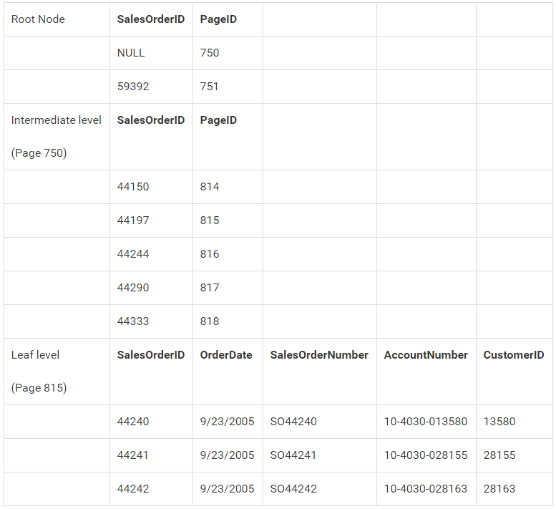
Clustered Index
Notes:
Algebrizer is responsible for objects and columns names (which you have provided in query or which are being referenced by your query) verification. For example if wrong name for a table is typed in a query, then its algebrizer’s duty to verify and generate an error.
· Algebrizer also identifies all data types which are being processed for a given query.
· Algebrizer verify that GROUP BY and aggregate columns are placed in right place or not. For example if you write following query and just Ctrl+F5 (just to parse). No error will be generated. But when you will press F5 (execute it). After Parsing, algebrizer will work and return an error.

Slide 15
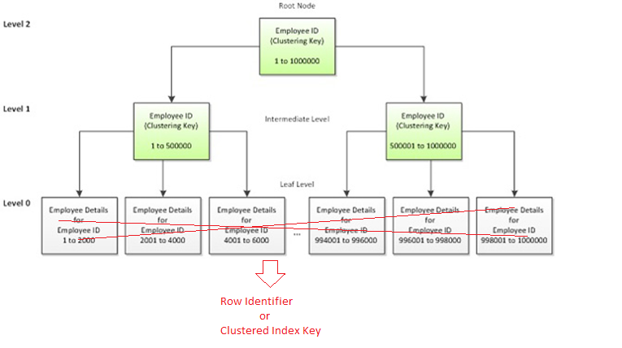
Non Clustered Index
Notes:
Algebrizer is responsible for objects and columns names (which you have provided in query or which are being referenced by your query) verification. For example if wrong name for a table is typed in a query, then its algebrizer’s duty to verify and generate an error.
· Algebrizer also identifies all data types which are being processed for a given query.
· Algebrizer verify that GROUP BY and aggregate columns are placed in right place or not. For example if you write following query and just Ctrl+F5 (just to parse). No error will be generated. But when you will press F5 (execute it). After Parsing, algebrizer will work and return an error.

Slide 16
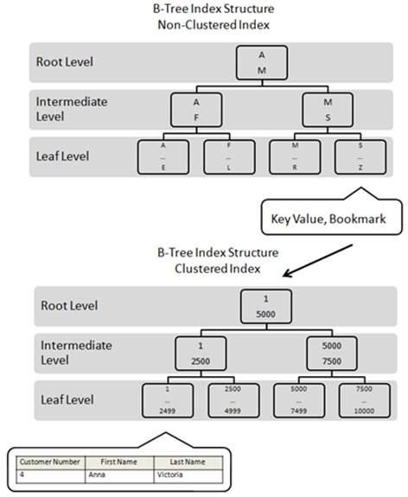
Non Clustered Index
Notes:
Algebrizer is responsible for objects and columns names (which you have provided in query or which are being referenced by your query) verification. For example if wrong name for a table is typed in a query, then its algebrizer’s duty to verify and generate an error.
· Algebrizer also identifies all data types which are being processed for a given query.
· Algebrizer verify that GROUP BY and aggregate columns are placed in right place or not. For example if you write following query and just Ctrl+F5 (just to parse). No error will be generated. But when you will press F5 (execute it). After Parsing, algebrizer will work and return an error.

Slide 17
Effect Index - Clustered
Narrow
Unique
Ever-Increasing
Static
Resources:
  https://www.simple-talk.com/sql/learn-sql-server/effective-clustered-indexes/

Slide 18
Effect Index - ALL
Columns in WHERE/ORDER BY
First column in composite index is important
Fast on SELECT (UPDATE/DELETE), Slow on data update (INSERT/UPDATE/DELETE)

Slide 19
Index Types
Covered index
  Composite index
  Include index
Filtered Index
  WHERE CLAUSE
XML Index
  XML Data Type
Column Store Index
  Data Warehouse

Slide 20
Identify Problematic Code
SQL Server Profiler
Extended Events
Visual Studio Profiler
ANTS Performance Profile

